Slide 1
Seminar 3 Design of Informatics Systems
UML Use case diagram (cont)

Slide 2
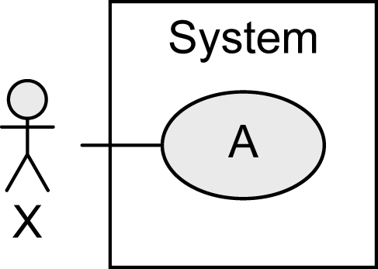
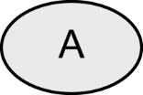
Notation Elements (1/2)
Name | Notation | Description
System |  | Boundaries between the system and the users of the system
Use case |  | Unit of functionality of the system
Actor |  | Role of the users of the system

Slide 3
Notation Elements (2/2)
Name | Notation | Description
Association |  | Relationship between use cases and actors
Generalization |  | Inheritance relationship between actors or use cases
Extend relationship |  | B extends A: optional use of use case B by use case A
Include relationship |  | A includes B: required use of use case B by use case A

Slide 4
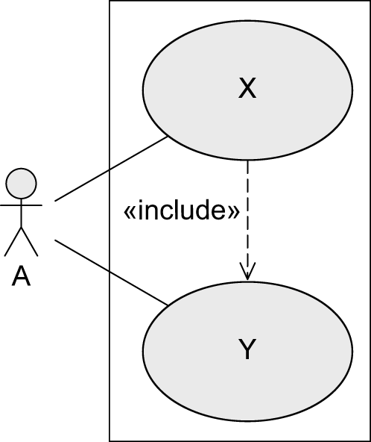
Best Practices
«include»
UML standard
Best practice

Slide 5
Best Practices
«extend»
UML standard
Best practice

Slide 6
Best Practices
Typical Errors To Avoid (1/5)
Use case diagrams do not model processes/workflows!

Slide 7
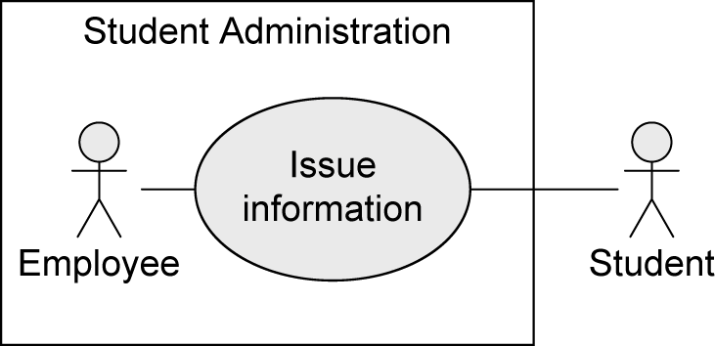
Best Practices
Typical Errors To Avoid (2/5)
Actors are not part of the system, hence, they are positioned outside the system boundaries!

Slide 8
Best Practices
Typical Errors To Avoid (3/5)
Use case Issue information needs EITHER one actor Assistant OR one actor Professor for execution
✓

Slide 9
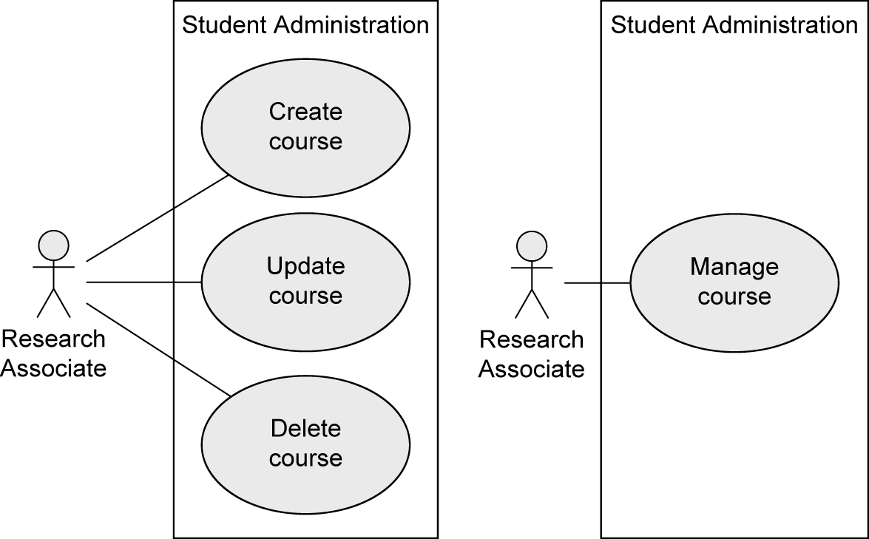
Best Practices
Typical Errors To Avoid (4/5)
Many small use cases that have the same objective may be grouped to form one use case
✓

Slide 10
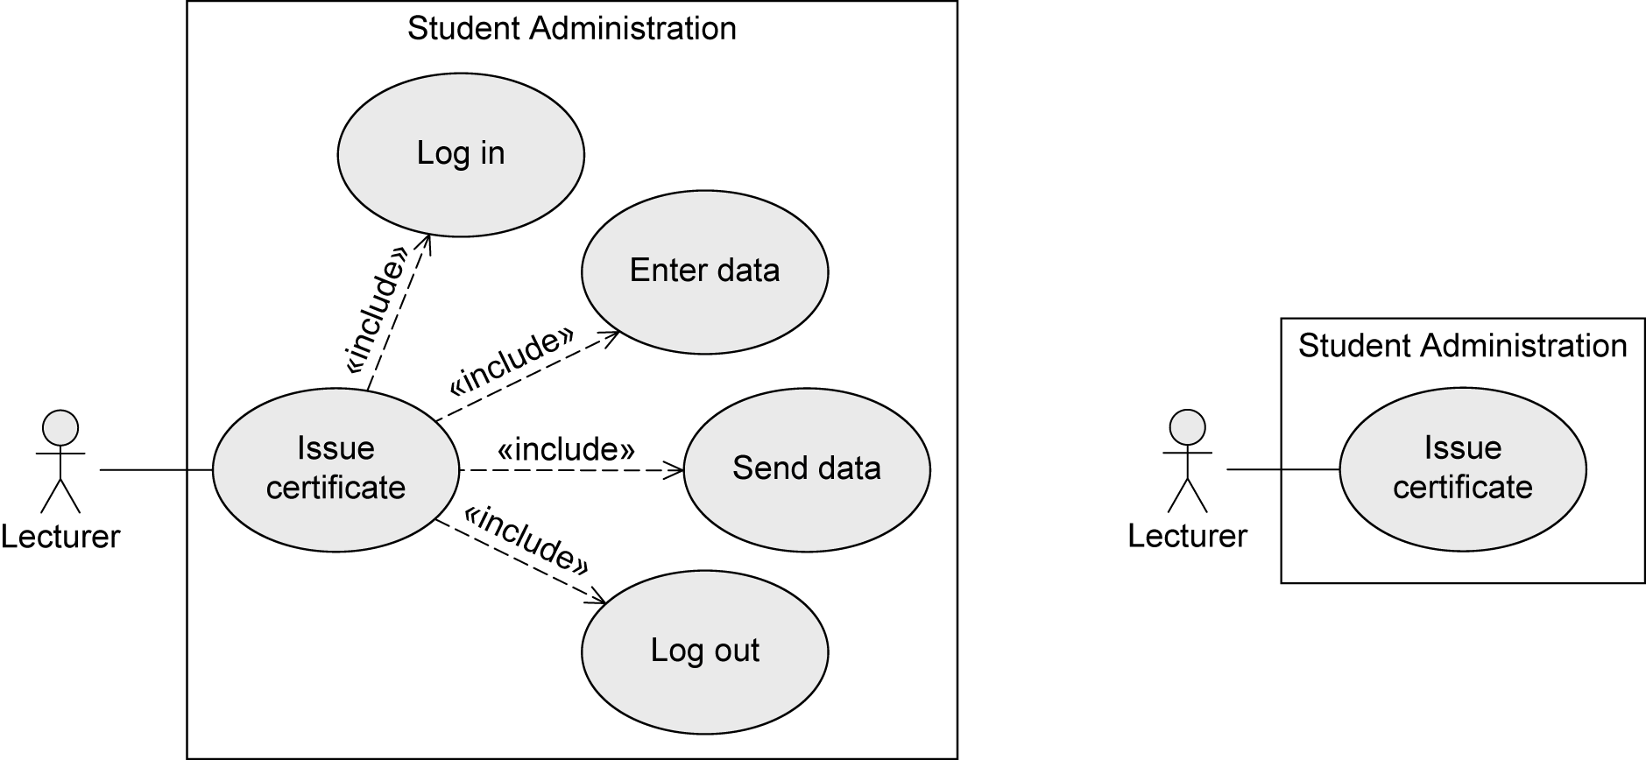
Best Practices
Typical Errors To Avoid (5/5)
The various steps are part of the use cases, not separate use cases themselves! -> NO functional decomposition
✓

Slide 11
Textual description of a UC
Element of the use case | Description
Code | Unique identifier associated to the use case
State | The stage of completion it is in, for example, outline, completed or approved
Purpose | The system (or part of the system) or application to which it belongs
Name | Name of the use case,as short and representative as possible
Main actor | The beneficiary who initiates the use case and pursues a particular purpose
Description | Short presentation, in free text, of the use case
Preconditions | What conditions must be satisfied for the script can begin
Postconditions | What conditions must be met to ensure a successful end of the scenario
Trigger | An event or sequence of events that initiate the use case
Basic flow | The basic flow describes the basic flow of events when everything is going according to a predetermined script; there are no exceptions or errors
Alternate flows | The most significant exceptions and alternatives to the baseline scenario
Relashionships | What relationships it has with other use cases (include or extend)
Frequency of use | How often it is expected to use this system functionality
Business rules | What rules govern the use case

Slide 12
Seminar work
Create the general use class diagram and the textual description for a use case,for the scenario below
The project goal is to develop a software application for the management of a hotel business unit. In order to check in, a customer can request to reserve one or more rooms by e-mail or telephone. For this, he provides the receptionist with information on the period of accommodation and type of rooms required. Customers will get discounts if they reserve at least 3 rooms or if the period of accommodation exceeds 5 days. The receptionist checks availability and notifies the client of this and the estimated cost of accommodation. If there are no rooms available as requested, the receptionist can provide alternatives to the customer. The client may request a discount (additional or not) and the receptionist will decide the feasibility discount, assisted mandatory by the hotel manager. If the client agrees with the proposed price, they proceed to the reservation. For new customers, the receptionist asks identification data, which he introduces in the application.
Once at the hotel and if he has made a prior booking, the customer will provide his identification and / or booking number and the check in is finalized. If there is no reservation, the availability for the required period will be checked. When there is such a room, accommodation is made. At the end of the stay, the receptionist prepares a list of all the services used by the customer and their price. The list must be validated by the customer, then the final invoice is drawn up. The invoice can be paid partially or fully by bank transfer, cash or using a credit card. Also, before leaving the hotel, the customer is asked to complete a form to evaluate the services provided by the hotel premises.

Slide 13
Use case element | Description
Code | CU01
State | Draft
Scope | Manage hotel accommodation activity
Name | Book rooms
Primary actor | Client
Description | It involves booking for one or more rooms
Preconditions | The receptionist is logged in the system
Postconditions | The booking was accomplished and the client receives booking confirmation.
Trigger | Client asks for booking one ore more rooms by email or by phone.
Main course | The client provides the receptionist with information on the period of accommodation and type of rooms required The receptionist checks room availability. The receptionist notifies the client that there are available rooms. [ A alternate course: There are not available rooms according to client requirements] The receptionist informs the client of the estimated costs. [Extention point: CU07 Decide discount granting] The client confirms booking period and agrees estimated cost. [B alternate course: the client doesn’t agree the booking conditions ] The receptionist asks the customer identification data. [C alternate course: customer data are already in the system] The receptionist enters customer data in the system. The receptionist makes room booking . The client receives the confirmation of booking.
Alternate courses | A: 1. The receptionist provides booking alternatives to the client. 2. The client selects an alternative and the scenario ends. B: 1. the client does not confirm booking and the scenario ends. C: 1. Go to step 8.
Relationships | Extended by CU07 Decide discount granting
Frequency of use | Very often
Business rules | When the client asks for discount, the receptionist can grant it only if manager agrees with it .

